Slide 1
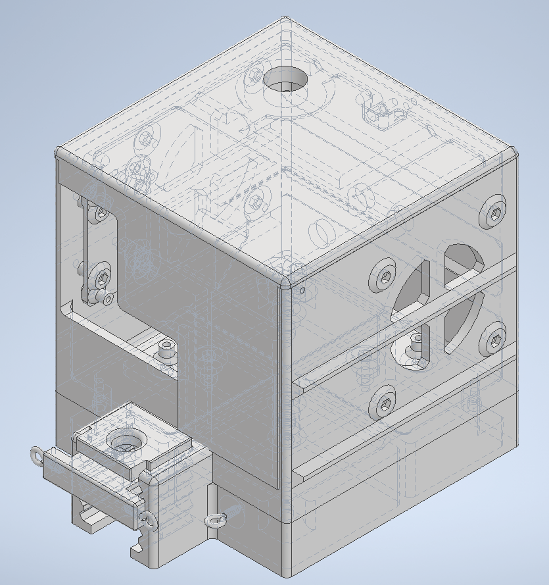
3D Printed Induction Annealer Design up to 50 BMG
N/O Momentary Switch
Lid Attachments
Timer and Plate(24V)
Coolant In and Return
Induction Coil and Plate 24V
Electrical (24V In)
TPU Case Guide (Swappable)
24V 80MM Fans
TPU Drop Plate (Adjustable)
Extension Spring Eyelets
Hardware
M2 Fasteners (Timer)
M3 Fasters Everywhere Else
9496T33 Routing Eye Bolt
¼” ID Tubing
External Systems
24 Volt Power Supply
Water Pump
Water Reservoir

